Slide 1

T-Test/anova Tutorials
Prof. Ah-Lian Kor

Slide 2
outline
Parametric versus Non-parametric tests
T-Test
ANOVA

Slide 3
Parametric versus non-parametric tests
Parametric Tests and Non-Parametric Tests
Normality Tests
Parametric Tests - T-Test
Parametric Tests - ANOVA

Slide 4
Parametric tests
Normal Distribution - sample data comes from a population that follows a normal distribution
Homogeneity of variance — the sample data come from a population with the same variance
Independence — the sample data consists of independent observations and are sampled randomly

Slide 5
Non-Parametric tests
Distribution free test (do not require to be normal distribution)
Does not require a distribution to meet the required assumptions to be analyzed

Slide 6
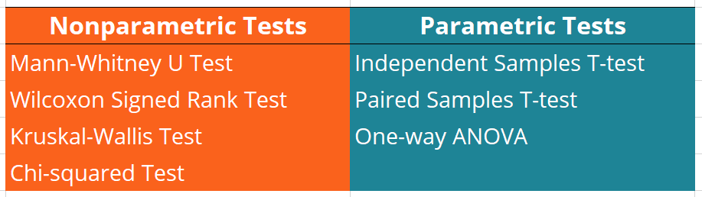
Parametric versus non-parametric tests
https://corporatefinanceinstitute.com/resources/data-science/nonparametric-tests/

Slide 7
Normality tests
https://docs.scipy.org/doc/scipy/reference/generated/scipy.stats.normaltest.html
Do on your own

Slide 8
T-Test
Types of T-tests
Concepts
Hypotheses Tests
Examples

Slide 9
Types of t-tests
Single sample t- tests
Compare sample means with the population means
Compare pre-intervention means and post-intervention means
Two sample t-tests
Compare means of two matched pair samples
Compare means of two independent samples

Slide 10
Concepts
Hypotheses testing - One-tail tests (left or right tail), two-tail tests
Confidence level
Significance level
T value
T critical value
Degree of Freedom
P-value
Errors

Slide 11
hypotheses
Single sample (pre-intervention means versus post intervention means)
•null hypothesis Ho: x̄1 = x̄2 (pre-intervention means is equal post-intervention means)
•Three options for alternative hypothesis Ha are:
•x̄1 < x̄2 (preintervention means is less than the post-intervention means – left tail test)
•x̄1 > x̄2 (pre-intervention means is greater than the post-intervention means – right tail test)
•x̄1 ≠ x̄2 (pre-intervention means is not equal to post-intervention means - two tail test i.e. left and right test)

Slide 12
Hypotheses
Single sample (sample means versus population means)
null hypothesis Ho: x̄ = μ (sample means is equal population means)
Three options for alternative hypothesis Ha are:
x̄ < μ ( sample means is less than the population means – left tail test)
x̄ > μ (sample means is greater than the population means – right tail test)
x̄ ≠ μ (sample means is not equal to population means - two tail test i.e. left and right test)

Slide 13
hypotheses
Two samples (sample1 means versus sample2 means)
•null hypothesis Ho: x̄1 = x̄2 (sample1 means is equal sample2 means)
•Three options for alternative hypothesis Ha are:
•x̄1 < x̄2 (sample1 means is less than sample2 means – left tail test)
•x̄1 > x̄2 (sample1 means is greater than sample2 means – right tail test)
•x̄1 ≠ x̄2 (sample1 means is not equal to sample2 means - two tail test i.e. left and right test)

Slide 14
Confidence level
Confidence level indicates the probability (or percentage), with which the estimation of the existence of a statistical parameter (e.g. an arithmetic mean) in a sample survey is also true for the population.
Confidence level refers to the percentage of all possible samples that can be expected to include the true population parameter
Confidence level to accept null hypothesis

Slide 15
significance level (α)
Significance level is the probability of rejecting the null hypothesis when it is true. ... Lower significance levels indicate that you require stronger evidence before you will reject the null hypothesis.
Significance level, α, = 100% - 95% (to reject null hypothesis)

Slide 16
Choice of confidence and significance levels
•Confidence Level 90%, α is 0.10
•Confidence Level 95%, α is 0.05
•Confidence Level 98%, α is 0.02
•Confidence Level 99%, α is 0.01

Slide 17
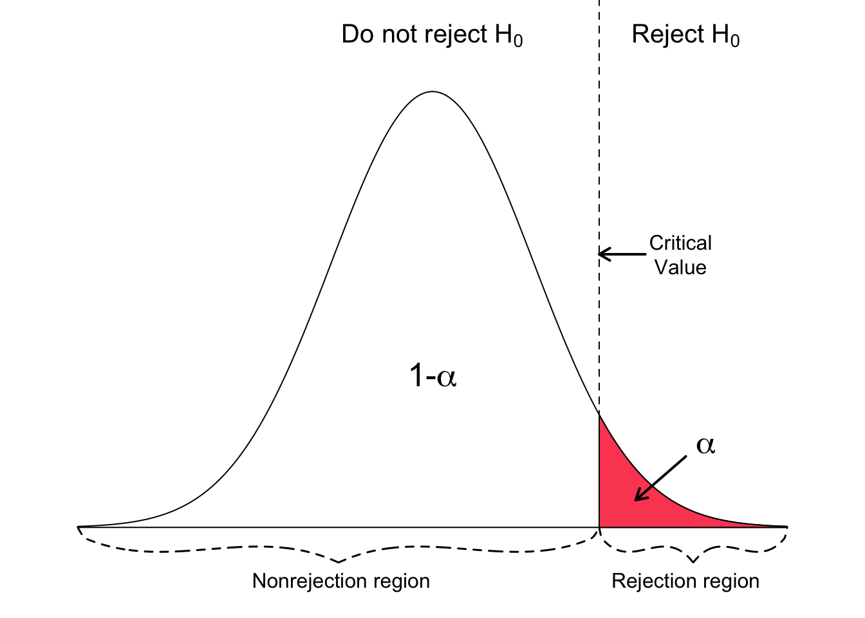
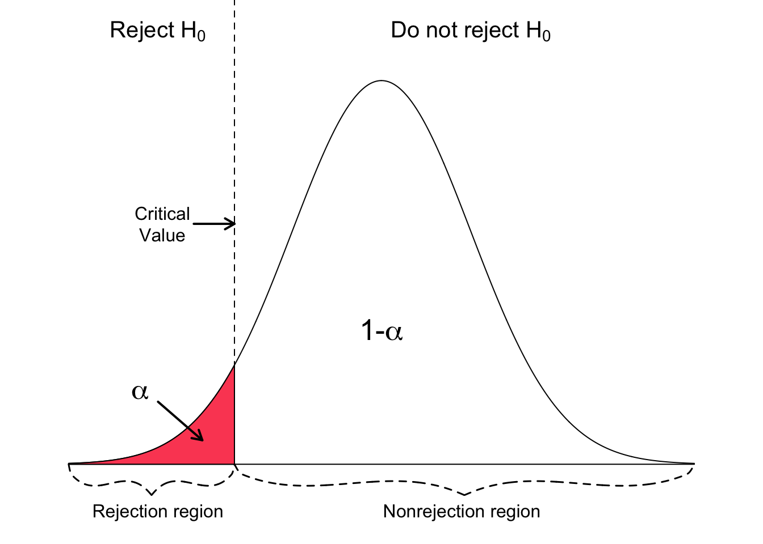
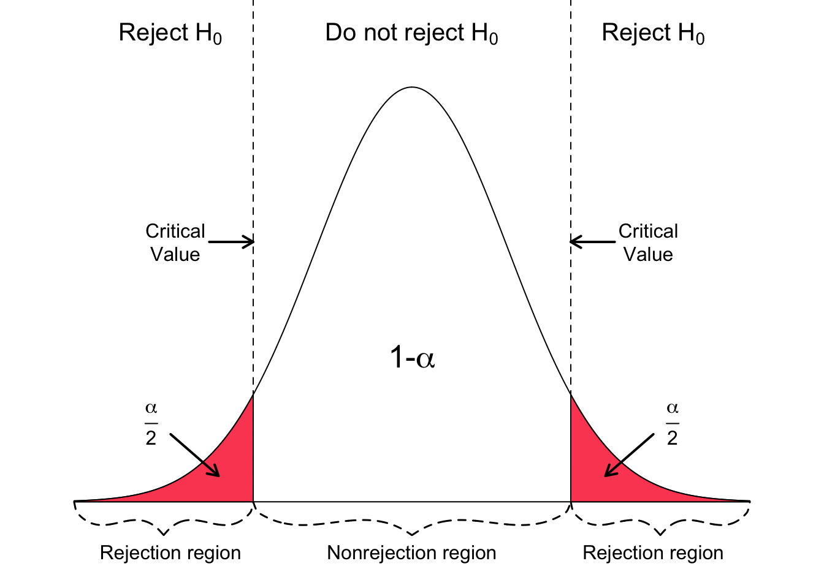
Concepts
Confidence level (1- α) - %
Confident that (1- α)% of data in sample (>, <) critical t-value or between 2 critical t-values
Significance level (α)
Probability of rejecting Ho when it is true
Errors
Type I error means rejecting the null hypothesis when it is actually true.
Type II error means failing to reject the null hypothesis when it is actually false.
https://www.geo.fu-berlin.de/en/v/soga/Basics-of-statistics/Hypothesis-Tests/Introduction-to-Hypothesis-Testing/Critical-Value-and-the-p-Value-Approach/index.html

Slide 18
Hypotheses testing
How to formulate hypotheses?
Based on t-value (or test statistics t) and p-value
When to accept Ho?
When to reject Ho?

Slide 19
Example 1 one sample
After treatment with a standard fertiliser, the average yield per hectare is 4.2 tonnes of wheat. A super fertiliser is developed and administered to 10 hectares. The yields from the 10 hectares were 4.3, 6.0, 4.9, 6.1, 6.2, 5.4, 4.1, 4.2, 3.8 and 3.9 tonnes. Does this fertiliser give a higher yield?

Slide 20

do the following tasks:
What is the sample mean?
What is the variance?
What is the standard deviation?

Slide 21
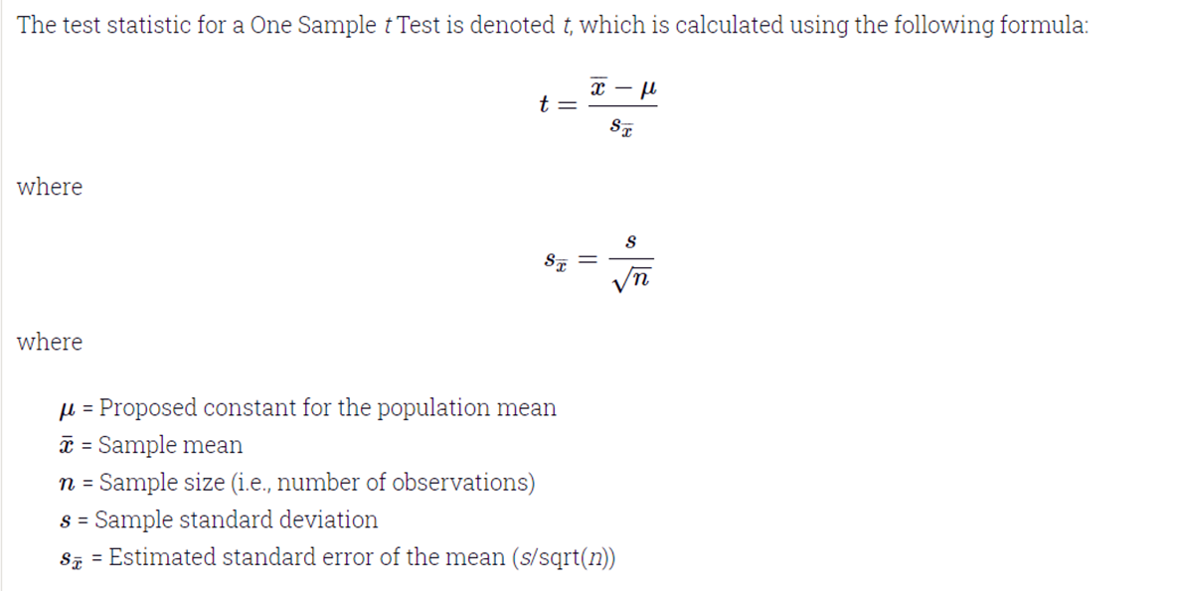
Example 1 one sample
What is the t-value?

Slide 22
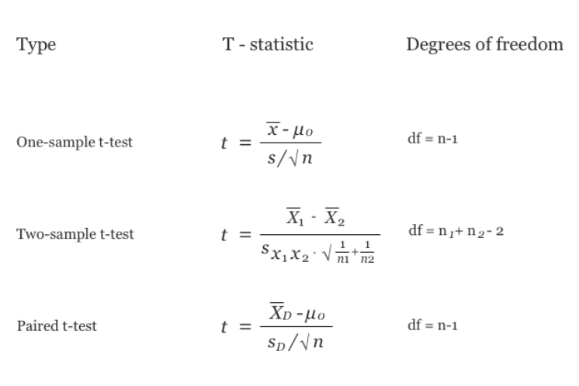
Example 1 one sample
Write down the two hypotheses
What is the degree of freedom?

Slide 23
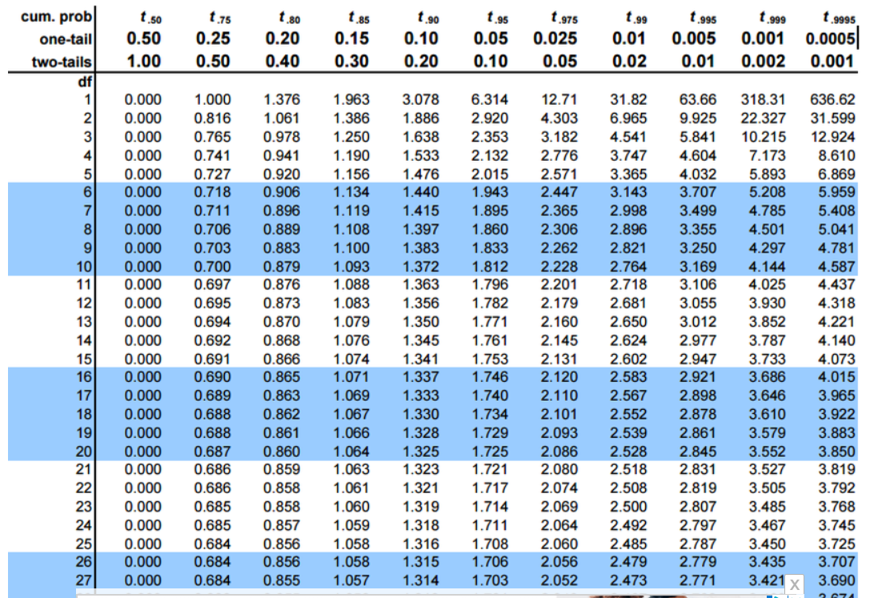
Example 1 one sample
Test the hypotheses at:
Confidence levels = 90%, 95%, 99%
For
One right-tail test

Slide 24
P-Value
Convert t-critical value to p-value
https://www.socscistatistics.com/pvalues/tdistribution.aspx

Slide 25
Example two independent samples
X1 | X2
200 | 190
210 | 200
190 | 190
200 | 180
190 | 190
200 | 200
180 | 190
200 | 210
200
210
Light bulbs 1 are made by company X while light bulbs 2 are made by company Y. The following are the lifespan of the light bulbs in hours.
Are the two type of light bulbs significantly different?

Slide 26
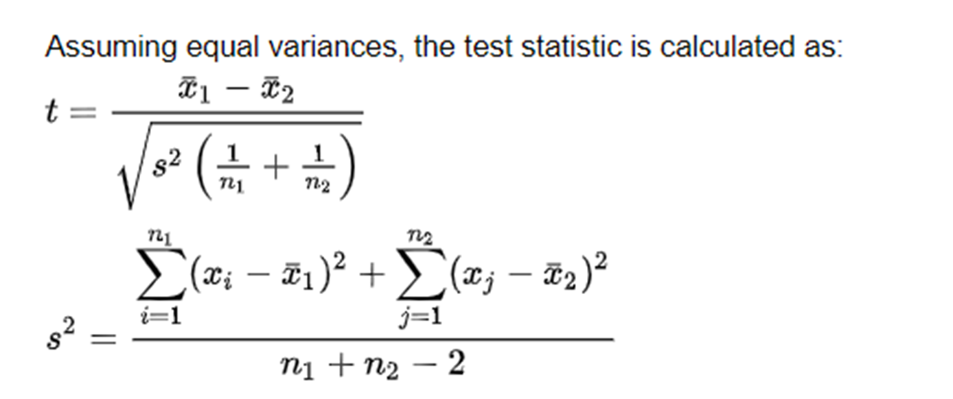
Calculate t-value for 2 unpaired samples

Slide 27
Summary - How to conduct t-test?
Calculate t-value
Convert t-value to p value
By hand https://www.statology.org/how-to-calculate-a-p-value-from-a-t-test-by-hand/
From a calculator https://www.socscistatistics.com/pvalues/tdistribution.aspx
From a table https://www.khanacademy.org/math/ap-statistics/tests-significance-ap/one-sample-t-test-mean/v/calculating-p-value-from-t-statistic
Find the degree of freedom (df)
1 single sample
For a 1-sample t-test, one degree of freedom is spent estimating the mean, and the remaining n - 1 degrees of freedom estimate variability.
2 samples
If you have two samples and want to find a parameter, like the mean, you have two “n”s to consider (sample 1 and sample 2). Degrees of freedom in that case is: Degrees of Freedom (Two Samples): (N₁ + N₂) – 2.

Slide 28
Summary - How to conduct t-test?
Formulate the null and alternative hypotheses
Set the confidence level
Consult a t-test table to determine the critical values

Slide 29
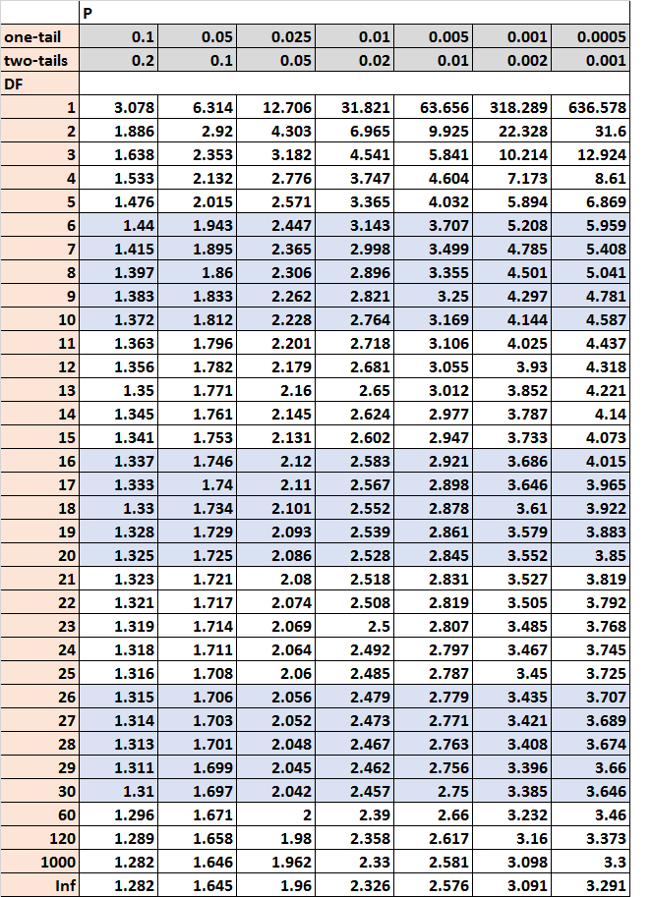
Formulate the null and alternative hypotheses
Set the confidence level
Consult a t-test table to determine the critical values

Slide 30
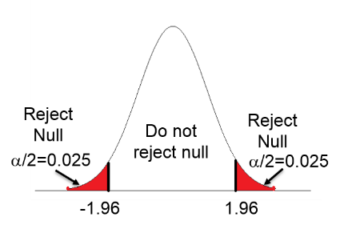
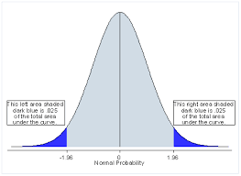
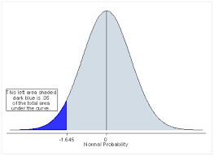
Compare t-value with t-critical values

Slide 31
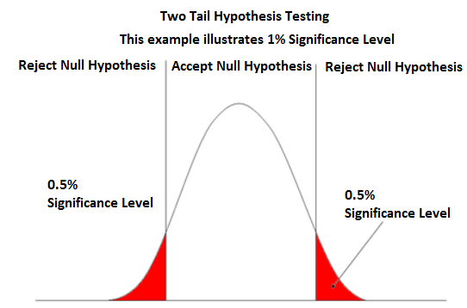
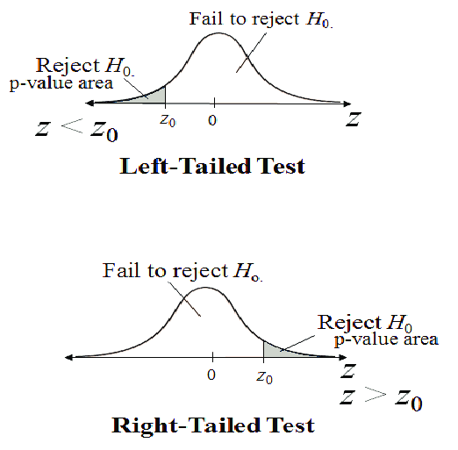
P-value
P-value

Slide 32
Finally Accept or Reject Null Hypothesis
Draw Conclusion

Slide 33
anova
Look at attached excel sheet

Slide 34
END

